Slide 1
Content
The main integral theorem and its applications
Magnetic circuits: overview
Use of the main integral theorem in magnetic circuits
Magnetomotive force (MMF) of a coil
Flux continuity and Kirchhoff’s first law for magnetic fluxes
Magnetic reluctance and redistribution of magnetic flux
Main steps in designing magnetic circuits
Coil permeance in a magnetic circuit
Self-induction effect and coil self-inductance in a magnetic circuit
Variable coil permeance and self-inductance
Inductively connected coils, mutual induction effect, and mutual inductance
Experimental determination of self-inductances
A case study on ferrite magnetic cores and Chan’s model

Slide 2
The main integral theorem and its applications
Circulation of
the magnetising force
Flux of the current density through S.
For these integrals, we have to agree on the integration direction for the contour integral and the orientation of normal vector n for the surface integral. The contour integration is positive (see Appendix 3 in Lecture 2) if the contour L is at the left when we move along it. In the theorem, the contour integral is assumed to be positive. To provide the physically correct sign, the vector n normal to the surface S must be orientated according to the right-hand screw driver rule if we rotate it in the positive integration direction.

Slide 3
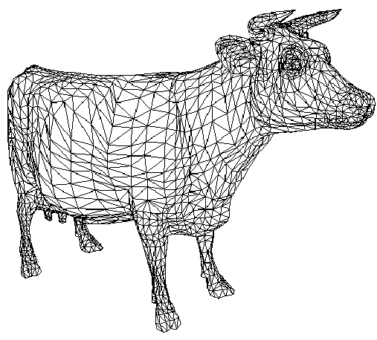
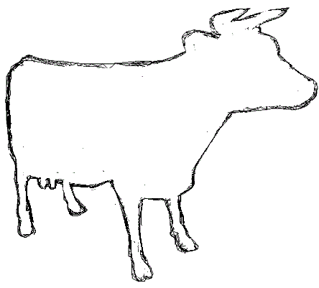
Surface integral
1) A surface is divided into small pieces Δs_{i} (of any shape), where i is the serial number of each piece.
2) For each piece Δs_{i} , we have to find the scalar product of a given vector field A (which can depend on coordinates) and the unit normal vector n both calculated in some point on this piece of surface, except its boundary. The normal vector n can be directed inside the volume or outside. The orientation of n is conventional and it is specified for each particular task.
3) The surface integral is defined as the following sum over all pieces with Δs_{i}→0:

Slide 4
Contour integral
1) A curve (2D or 3D) is divided into small pieces Δl_{i}, where i is the serial number of each piece.
2) For each piece Δl_{i} , we have to find the scalar product of the given vector field A (which can depend on coordinates) and the unit tangent vector τ both calculated in some point on this piece of the contour, except its ends. There is the agreement that the contour integration is positive if the contour is at the left when we move along it. The tangent vector τ is directed along this positive motion.
3) The contour integral is defined as the following sum over all pieces with Δl_{i}→0:

Slide 5
A straight wire current
Total current
The current is directed to YOU (its cross-section)

Slide 6
Inside a straight wire current...

Slide 7
Inside and outside a straight wire current

Slide 8
A very long solenoid
Currents to YOU
Currents from YOU
I – feed current
N – total number of turns (one or several layers)

Slide 9
Some important conclusions
From the previous examples we can see that an effective use of the main integral theorem is possible only if we can make some simplifying assumptions about fields or currents.
In the case of a straight wire current, we used the circular symmetry of the magnetic field. That was enough to find the amplitude of magnetising force.
In the case of a long solenoid, we can neglect the magnetising force outside the solenoid, while inside the solenoid the field is approximately constant.

Slide 10
Magnetic circuits: collective picture
Main properties:
Coils used in magnetic circuits are not long anymore. However, for a closed circuit, the magnetic flux will be concentrated inside the core(s).
Small air gaps will have a very weak magnetic field leakage.
Coil
Coil
Moving part
Air gap(s)
The core is made of a soft ferromagnetic material with a small coercivity (narrow hysteresis loop).

Slide 11
Use of the main integral theorem in magnetic circuits
The main integral theorem can be used for each closed loop (branch) in a magnetic circuit. The loop shown below has two coils and one air gap.
Coils

Slide 12
H₄ ≠ 0
H₂ ≠ 0
H₃ ≠ 0

Slide 13
A feed current is positive if it is
directed from YOU in these internal turns.
H₄ ≠ 0
H₂ ≠ 0
H₃ ≠ 0

Slide 14
I_{i} − feed current in each coil which can be positive or negative (see the previous slide)
N_{i} − total number of turns in each coil
I_{i}×N_{i} − magnetomotive force (MMF) of the coil (A, SI)
All parts in a magnetic circuit may have different lengths, cross-sections, and permeabilities.
The length of each part in a magnetic circuit is measured along the centreline inside the core.

Slide 15
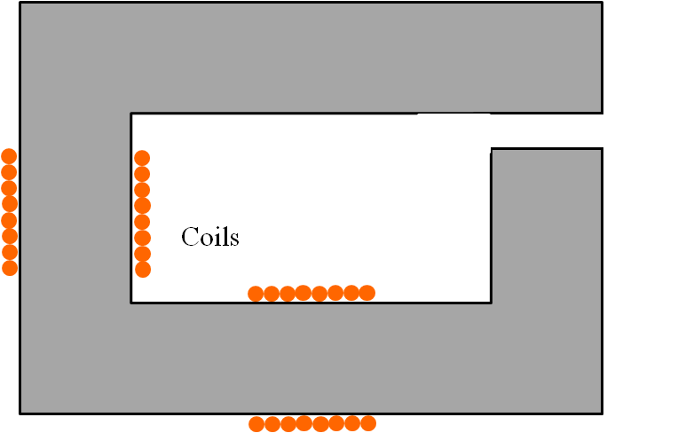
Flux continuity
Let us consider a single loop magnetic circuit without junctions
The normal induction components in the gap and at any interface between different magnetic materials are continuous due to the boundary condition (see below and Lecture 2). Since the flux is the induction normal component multiplied by the cross-section, we obtain that the flux is also continuous at any interface or gap.
The boundary condition for the induction normal components.

Slide 16
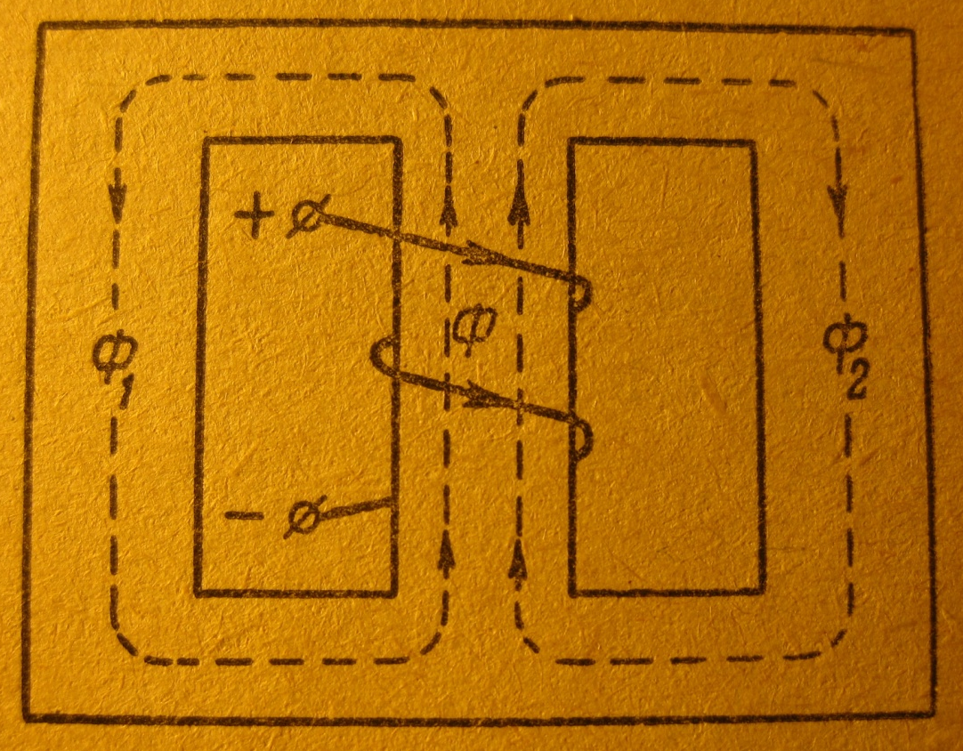
First Kirchhoff’s law for magnetic fluxes
Junction
In a junction
Junction
The algebraic sum of all magnetic fluxes in a junction equals zero. In this sum, a flux is positive if it comes to the junction and negative if it leaves the junction.

Slide 17
Magnetic reluctance
Let us consider a single loop magnetic circuit without junctions.

Slide 18
Magnetic reluctance of a single loop
(A/Wb, Ampere per Weber, SI)
− magnetic reluctance of each part in the loop.

Slide 19
Second Kirchhoff’s law for a magnetic loop
Analogy with electric circuits: magnetic Ohm’s law
Current
×
Resistance
=
Voltage

Slide 20
Magnetic reluctance
The permeability μ of ferromagnetic materials is not constant! It varies with frequency, waveshape of applied signals, temperature, and induction. The double-valued nature of permeability gives rise to the well-known hysteresis curve, which is only approximate, varying from batch to batch of the same material. The elusive nature of permeability is one reason that the study of magnetic devices and circuits appears somewhat esoteric. The analysis of magnetic circuits generally uses constant and single-valued approximations for permeability over a limited range. Selecting these approximations and their boundaries is a major task of magnetic design.
In the majority of magnetic circuits consisting of iron parts and one or more air gaps, the reluctance of the iron parts is very much less than the reluctance of the gaps. At first sight this can seem surprising, since the distance across the gap is so much less than the rest of the path through the iron. The fact that the air gap dominates the reluctance is simply a reflection of how poor air is as a magnetic medium, compared with iron.

Slide 21
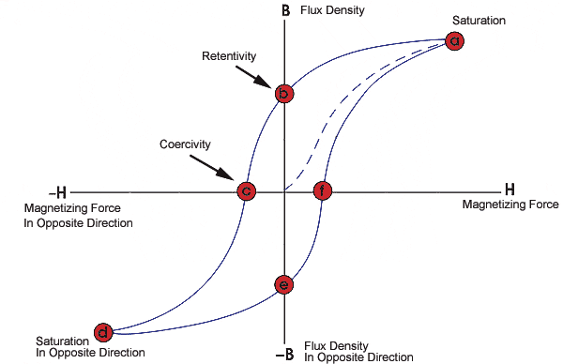
Magnetic saturation
It would be reasonable to ask whether there is any limit to the induction at which the iron can be operated. In the previous slides we have noted that the iron has almost no reluctance, at least not in comparison with air. Unfortunately this property is true as long as the induction remains below about 1.6−1.8 T (Tesla, SI), depending on the particular steel in question. If we try to work the iron at higher induction, where it is saturated (see the hysteresis loop), the permeability becomes very small and the iron core begins to exhibit significant reluctance, and no longer behaves like an ideal conductor of flux. To avoid the undesirable effects of saturation, the cross-section S of the iron parts of the magnetic circuit are usually chosen so that the induction B = Φ/S does not exceed about 1.5 T. For the hysteresis loop shown below, the permeability μ is high and approximately constant in the middle part of the loop, where the blue line (high permeability) and red lines (saturation) are the linear approximations of the BH function. For the blue line, μ = B(H) /μ₀H = const and the iron reluctance is very low.
Iron reluctance
μ = B(H) /(μ₀H) = const
1
Induction, T
2

Slide 22
General form of the material equation used in magnetism
M (A/m, Ampere per meter, SI) is the magnetic polarisation or magnetisation
Therefore, inside a magnetic material along with the external induction μ₀H there is an additional magnetic induction μ₀M. This additional induction is produced by the magnetic atoms – “elementary magnets”. In ferromagnetic materials, the magnetisation M can exist even without an external magnetising force – the so-called “spontaneous” magnetisation. In the presence of an external magnetising force, M is a non-linear function of H.

Slide 23
Linear magnetic response
For weak fields, the relation between the magnetic induction and the magnetising force may become approximately linear:
μ (dimensionless) is the permeability matrix
This linear relation is used in high frequency applications operating with very weak fields: ferrites in waveguides and antennas, spin waves, magnetoimpedance sensors, and so on. But, it is not adequate for actuators where the fields are usually strong or very strong.
Non-linear magnetic media
In general case, the magnetic induction will be a non-linear function of the magnetising force. For the magnetic induction measured in the direction of an external magnetising force, we can introduce the following permeabilities:

Slide 24
Non-linear functions typical for ferromagnetic materials

Slide 25
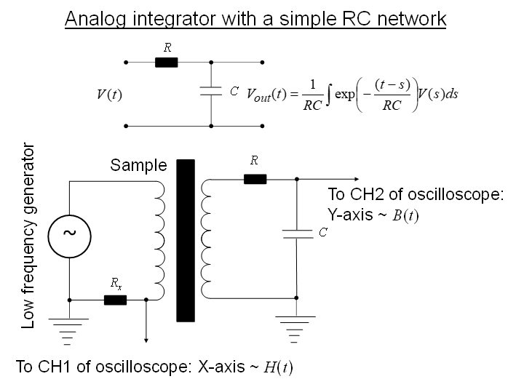

Slide 26
Redistribution of magnetic flux
l
“Common path”
“Left loop”
“Right loop”
l₁
l₂

Slide 27
Redistribution of magnetic flux
The left and right loops, and also the common path can be made of different magnetic materials.

Slide 28
Redistribution of magnetic flux

Slide 29
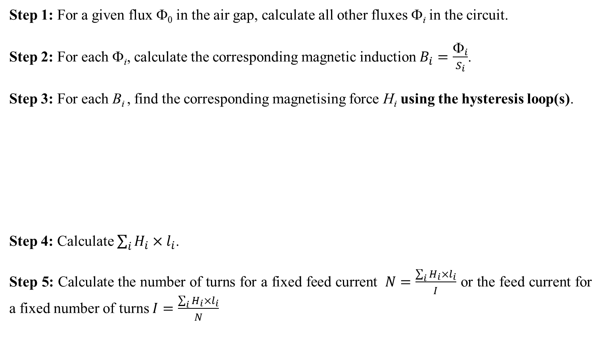
The main steps in designing a magnetic circuit
Typical task: For a given geometry of magnetic circuit and a given magnetic flux in the air gap, we have to find the coil parameters: (i) the number of turns for a fixed feed current or (ii) the feed current for a fixed number of turns.
Step 1: For a given flux Φ₀ in the air gap, calculate all other fluxes Φ_{i} in the circuit.
Step 2: For each Φ_{i}, calculate the corresponding magnetic induction $B_{i}=\frac{Φ_{i}}{S_{i}}$.
Step 3: For each B_{i} , find the corresponding magnetising force H_{i} using the hysteresis loop(s).
Step 4: Calculate $\sum_{i}{H_{i}×l_{i}}$.
Step 5: Calculate the number of turns for a fixed feed current $N=\frac{\sum_{i}{H_{i}×l_{i}}}{I}$ or the feed current for a fixed number of turns $I=\frac{\sum_{i}{H_{i}×l_{i}}}{N}$

Slide 30
Permeability and magnetic circuit design
If the magnetising forces in a soft magnetic circuit do not saturate it, we can use permeabilities and reluctances to calculate all the circuit parameters.

Slide 31
Summary
− the main integral theorem reformulated for magnetic circuits
− magnetomotive force
− magnetic reluctance
− First Kirchhoff’s law for magnetic fluxes in a junction

Slide 32
Flux in a single loop magnetic circuit with a coil
Coil
N – number of turns
I – feed current

Slide 33
Coil permeance P
This proportionality coefficient P between the flux Φ through the coil and the feed current I is called the permeance.
The relation Φ = P×I remains true for any single or multiple loop magnetic circuit if Φ is the magnetic flux through a particular coil with the feed current I. Then, P will be the permeance of this coil.
Note that all parts of a magnetic circuit affect the coil permeance, not only the part inside the coil.

Slide 34
Self-induction effect in a coil
Coil
N – number of turns
I – feed current
The additional e.m.f. V(t) induced in the coil by the flux Φ (Faraday’s law).
− self-induction effect

Slide 35
Coil self-inductance L
The additional e.m.f. V(t) induced in the coil
This proportionality coefficient L (H, Henry, SI) is called the self-inductance. Note that all parts of a magnetic circuit affect the coil self-inductance, not only the part inside the coil.

Slide 36
Variable permeance P(t) and self-inductance L(t)
Along with an alternating feed current I(t), some parts in the magnetic circuit may move: the rotation θ(t) or the linear displacement x(t):
The additional e.m.f. V(t) induced in the coil.

Slide 37
Variable permeance P(t) and self-inductance L(t)
To simplify the analysis, we should separate the circuit internal properties from the dynamic equation for θ(t) or x(t). To do this, when calculating the derivative ∂L(t)/∂t we have to replace the partial time derivative ∂/∂t with the total time derivative d/dt:
The additional e.m.f. V(t) induced in the coil

Slide 38
Two inductively connected coils (transformer) and
mutual induction effect
Mutual induction effect, where V₁(t) and V₂(t) are the electromotive forces induced in the coils.

Slide 39
Mutual inductances M₁₂ and M₂₁

Slide 40
Mutual inductances M₁₂ and M₂₁
This relation is true only for the ideal magnetic circuits without leakage.
General relation

Slide 41
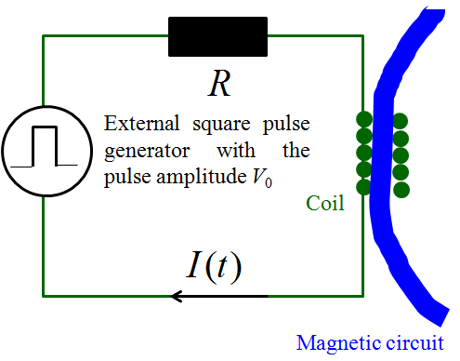
Experimental determination of the coil self-inductance
The self-inductance L of a coil can be found by measuring the characteristic time τ of the current transition process in the electric circuit with the square pulse voltage excitation, shown below. All other coils must be disconnected (zero current). In formulas, R is the total circuit resistance!
To oscilloscope V_{Rx}(t) = I(t)×R_{x}
YT-mode
R_{x} – signal resistor

Slide 42
Summary
− coil permeance which can depend on the time
− magnetic flux
− coil self-inductance which can depend on the time
− e.m.f. V(t) induced in the coil by the feed current I(t) (self-induction effect) if L = const

Slide 43

Dr. Dmitriy Makhnovskiy City College Plymouth, England 06.03.2024
In this report, we revise the fundamental equations employed in the analysis of magnetic circuits and demonstrate their application through the example of a ferrite E-core. The content presented here is straightforward and elementary in nature. However, complications arise when addressing magnetic hysteresis. To tackle this challenge, we employ Chan's model, a methodology also employed in LTspice for simulating nonlinear inductances or transformers. The approach we have devised enables the computation of magnetic cores utilizing experimentally derived hysteresis BH-loops.

Slide 44

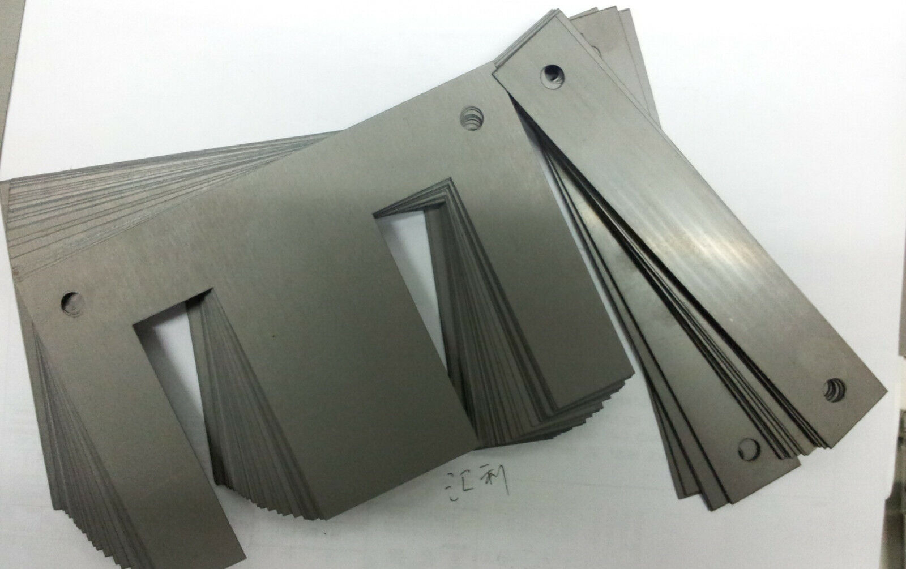
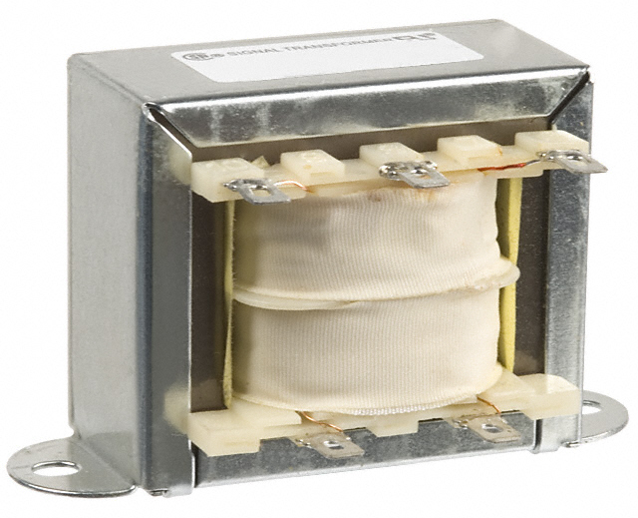
Ferrite cores
Laminated steel cores

Slide 45
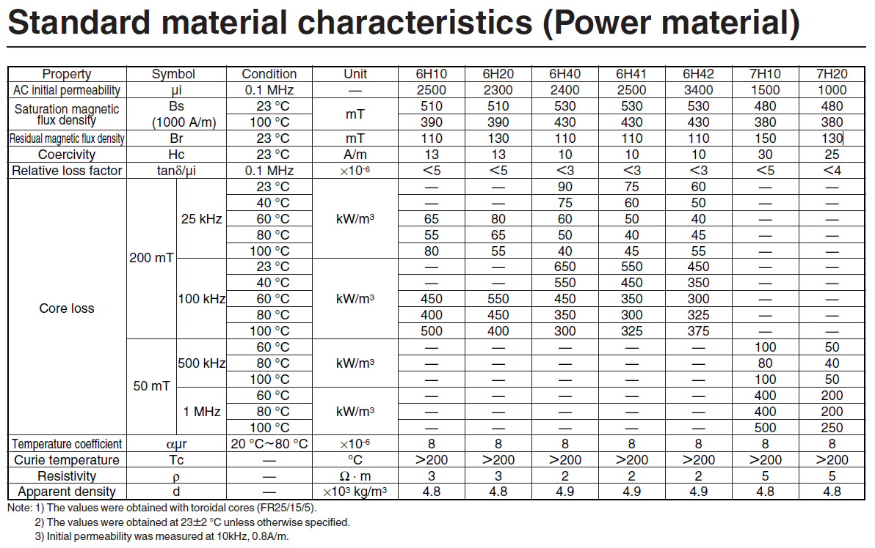
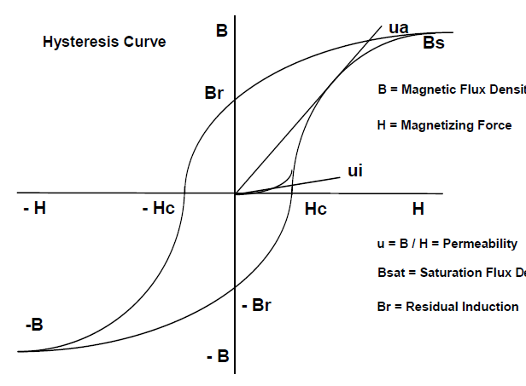
Ferrite cores
Magnetic saturation is an asymptotic state. Therefore, it is indicated for which H (1000 A/m) the induction (flux density) B was measured when approaching its saturation value.
Materials are only ferromagnetic below their corresponding Curie temperatures.

Slide 46
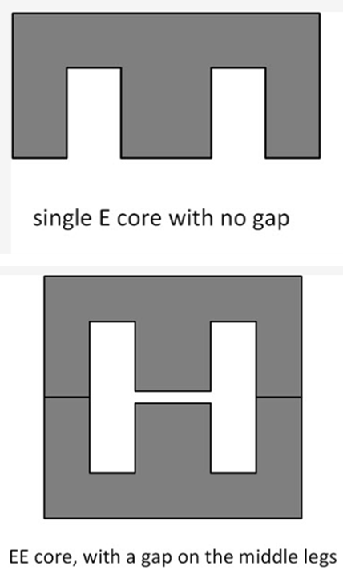
Ferrite magnetic core: a case study
https://www.digikey.co.uk/en/maker/projects/85v-260vac-to-5vdc-2.5a-flyback-switching-power-supply/848a9fa1b7d44244805e0540e3a14441?utm_campaign=an_ac-to-dc_flyback_switc&utm_content=digikey&utm_medium=social&utm_source=twitter
Core: Ferrite, EE-20-10-6 (B66311G0000X187)
Primary Winding: 2.88 mH (124 turns of 0.2 mm wire)
Gap: ∼0.25 mm (mathematically)
Secondary Winding: 6 turns of 2 * 0.7 mm wires (two 0.7 mm wires in parallel)
Usually, EE cores come with no gap (a gap between the two middle legs of the core). Therefore, you have to grind the middle EE legs equally to build a gap, but making such a gap accurately and winding the transformer by hand and without any error is difficult. The easy solution is to use an LCR meter. First, wind the primary and assemble the transformer (without any gap). Then measure the inductance of the primary. Naturally, the inductance would be higher than 2.88 mH. Therefore, you have to grind the middle leg of the EE ferrite and build a gap, then assemble the transformer again and measure the inductance of the primary. As a result, simply increase the gap and continuously measure the primary inductance till it gets as close as possible to 2.88 mH. A little tolerance from 2.88 mH is fine and does not make any difference. Figure shows the EE core and the gap. This is the simplest flyback transformer with one primary and one secondary winding.
Ungapped core
Gapped core

Slide 47
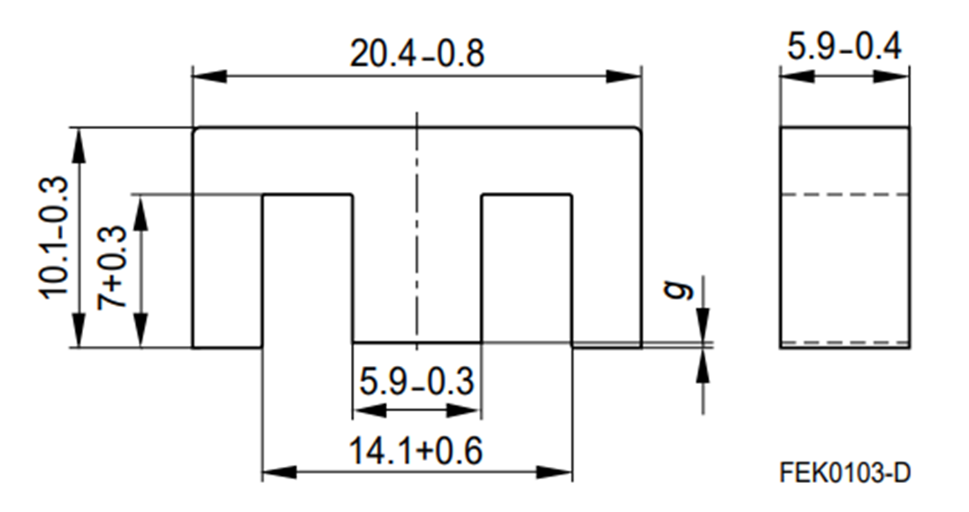
Ferrite E-core used in this case study
https://www.farnell.com/datasheets/1756165.pdf
Ungapped core
Gapped core

Slide 48
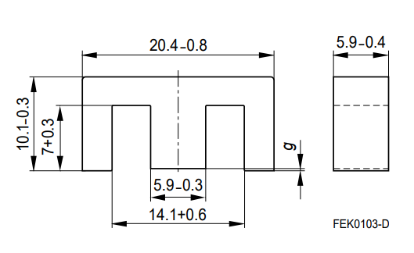
Design equations and magnetic circuit segments
− reluctance (H⁻¹) of a magnetic segment with a length l_{i} and cross-section S_{i}
MMF – magnetomotive force (Amperes × turns)
− magnetic flux (Weber, Wb) calculated in a single loop core
In a branched core, Φ is calculated using KVL & KCL
− induction or flux density (Tesla, T)
− magnetising force (A/m)
− inductance (Henry, H)

Slide 49
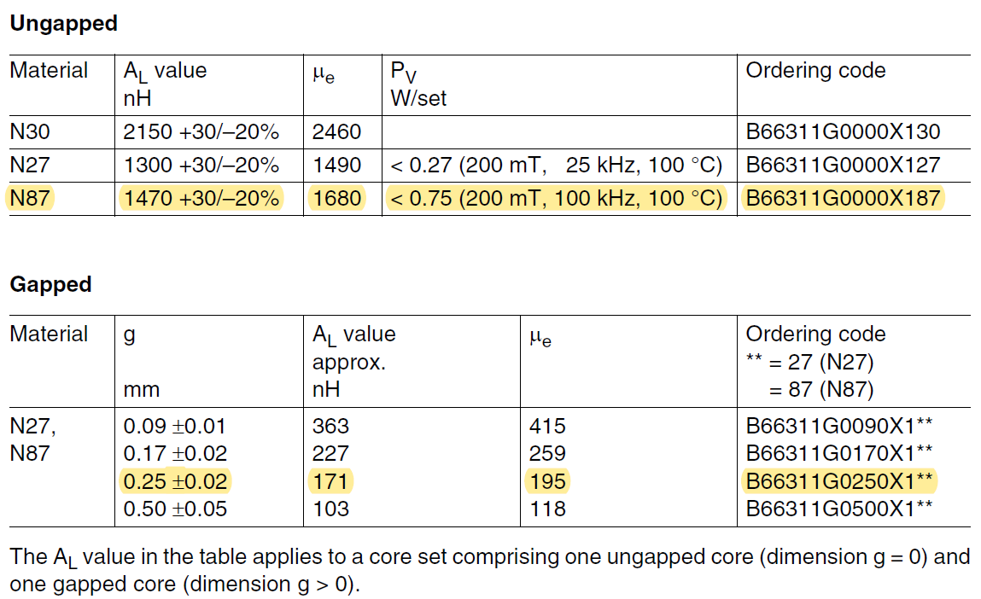
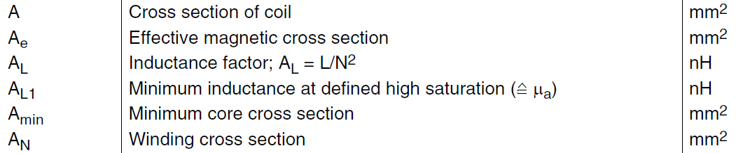
https://www.farnell.com/datasheets/1756165.pdf
Total gap!

Slide 50
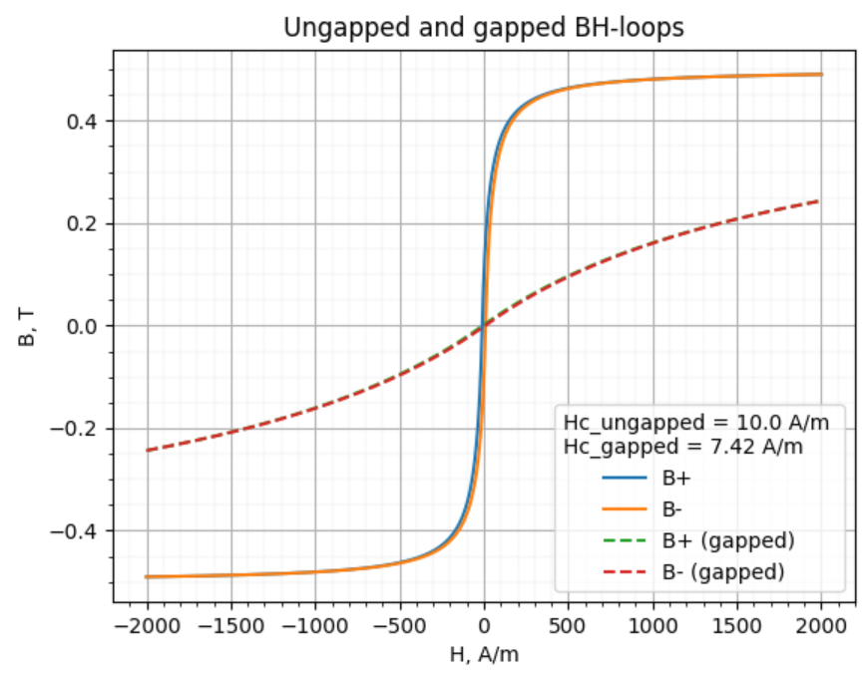
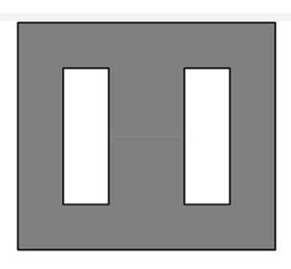
The saturation properties of a magnetic core are equally if not more important than dimensions, A_{L} value (see the previous slide) and core loss and should also be specified measured and monitored. In many applications if the core saturates, the inductance and impedance of the component decreases and causes the circuit currents to escalate. Excessive currents can cause other circuit components (semiconductor switches, diodes, capacitors) to fail. The saturated core is hard to determine as the root cause since this failure mode typically exhibits no permanent damage to the ferrite core and the magnetic component.
Chan’s BH-loop model
discussed below
The slope of flux density (B) divided by magnetizing force (H) is the effective permeability. Permeability is a material’s ability to conduct magnetic flux relative to air and is proportional to a component’s inductance. Note that as the material saturates the slope of B/H decreases, thus the inductance of a component decreases. Introducing an air gap in the magnetic flux path sheers the hysteresis loop so that it requires more magnetizing force to saturate the core. The more air gap introduced into the flux path the lower the permeability (ratio of B/H). Note that the saturation flux density is unchanged even though a gapped core requires more magnetizing force before reaching saturation.

Slide 51
Estimated cross-sections
18.59 mm²
18.29 mm²
34.81 mm²

Slide 52
Reluctances of three segments in the magnetic E-core
18.59 mm²
18.29 mm²
34.81 mm²

Slide 53
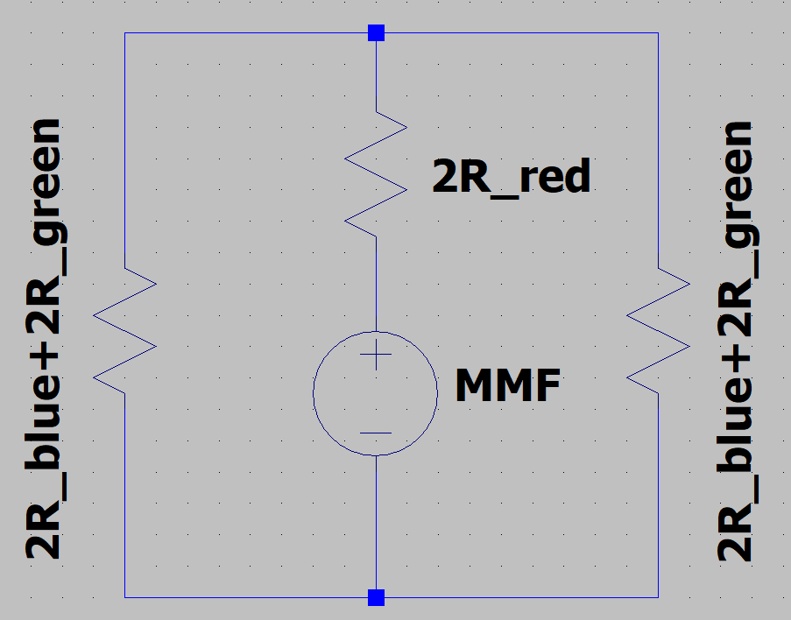
Equivalent electrical circuit

Slide 54
$$For N=124:18.1 mH<L<29.38 mH$$
The calculated value is in the middle of the tolerance interval

Slide 55
18.59 mm²
18.29 mm²
34.81 mm²
Total symmetrical gap!

Slide 56
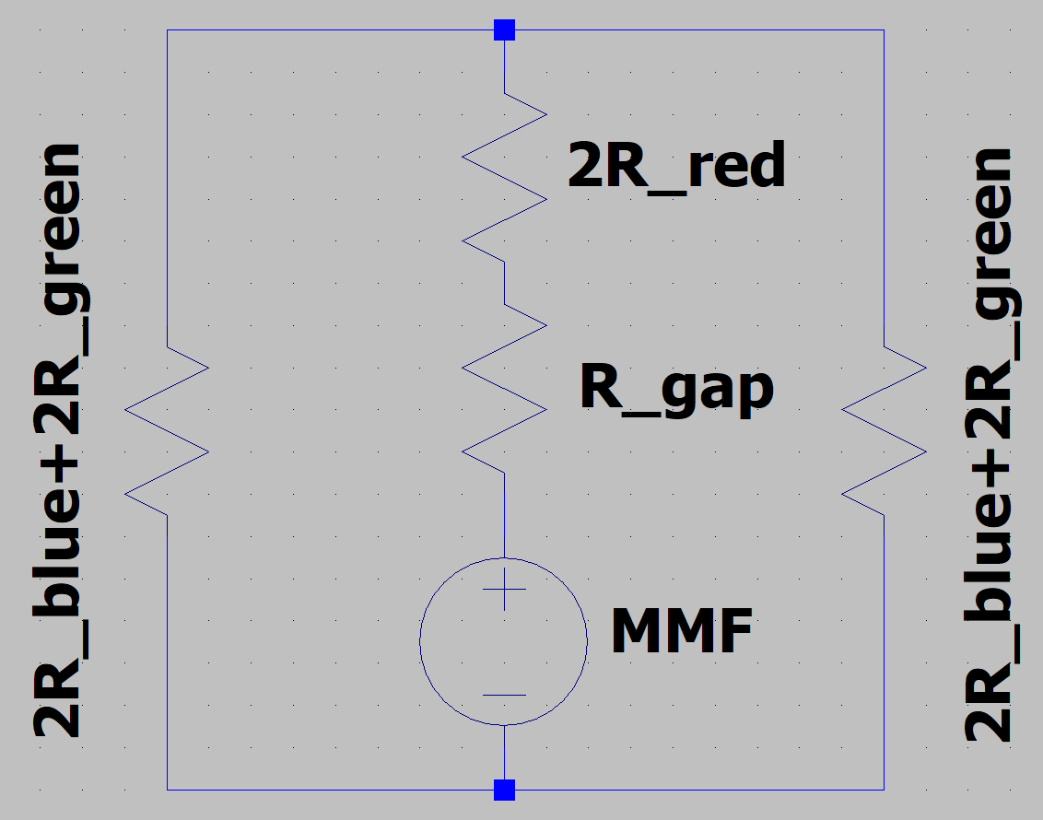
Equivalent electrical circuit

Slide 57

$$For N=124:L=2.63 mH$$

Slide 58
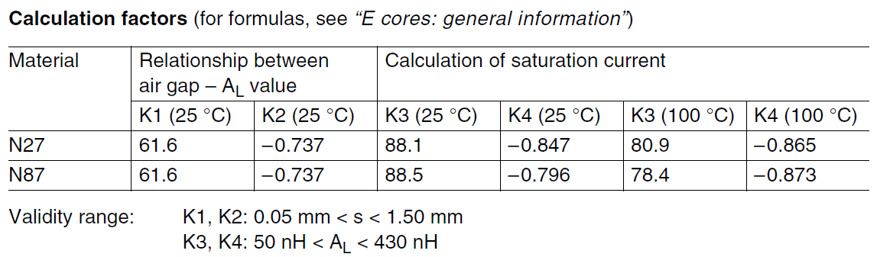
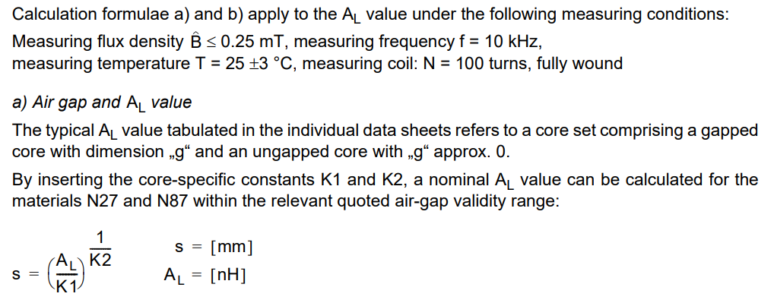
https://www.farnell.com/datasheets/1756165.pdf

Slide 59
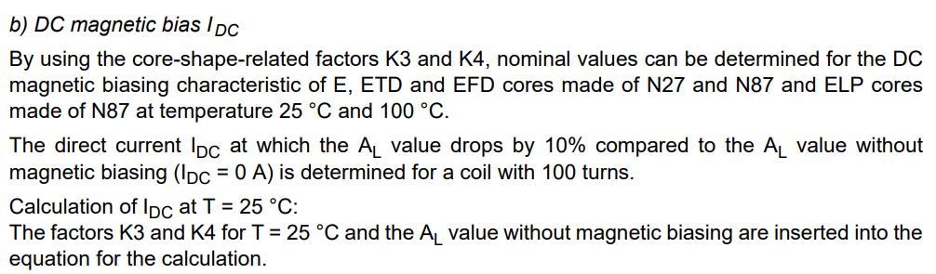
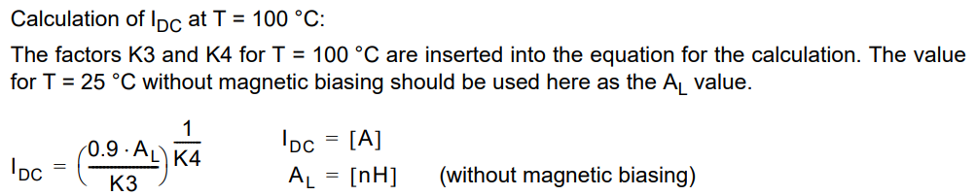
https://www.farnell.com/datasheets/1756165.pdf
$$For A_{L}=171 \left(gapped\right) and N=100: I_{DC}≈0.5 A$$

Slide 60
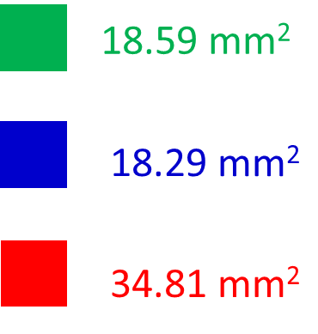
$$I=0.5 A −beggining of the saturation$$
All parts are approximately at the same magnetic condition

Slide 61
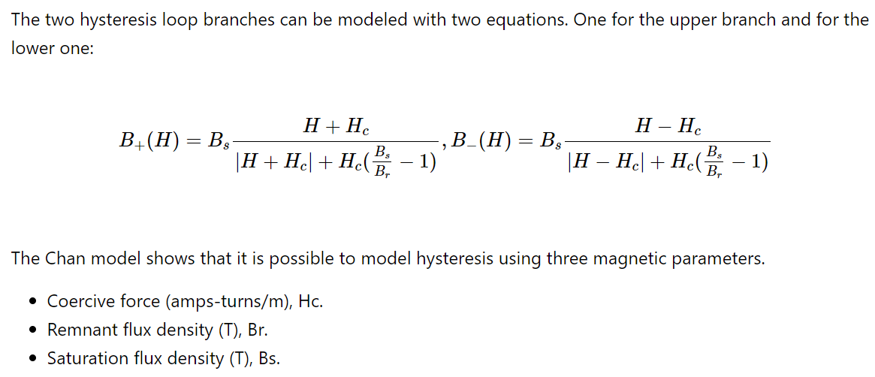
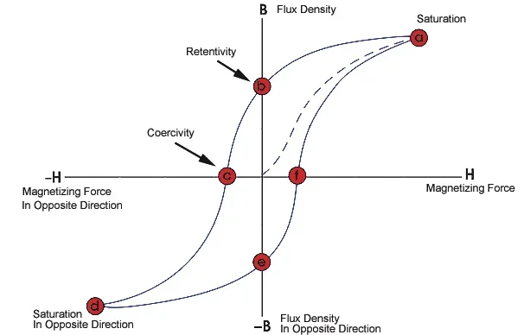
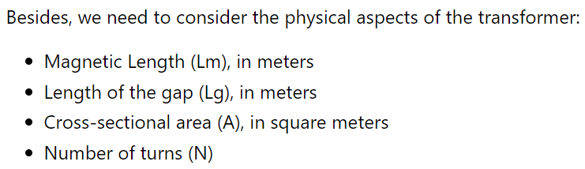
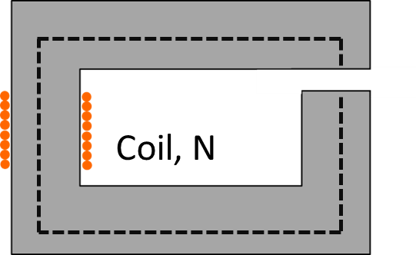
Simulating Non-linear Transformers in LTspice
https://www.allaboutcircuits.com/technical-articles/simulating-non-linear-transformers-in-ltspice/
Chan’s model: https://ieeexplore.ieee.org/document/75630

Slide 62
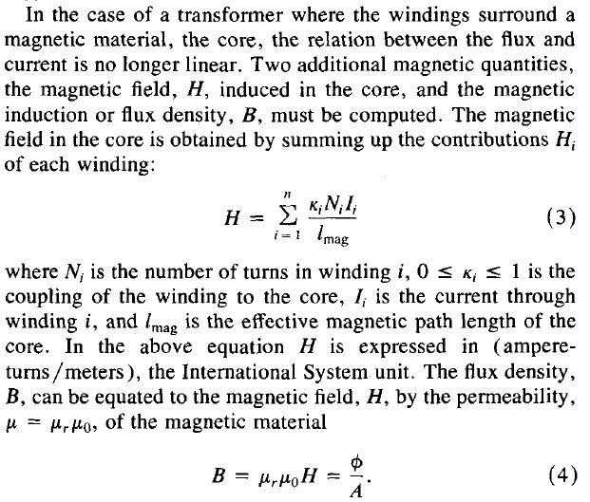
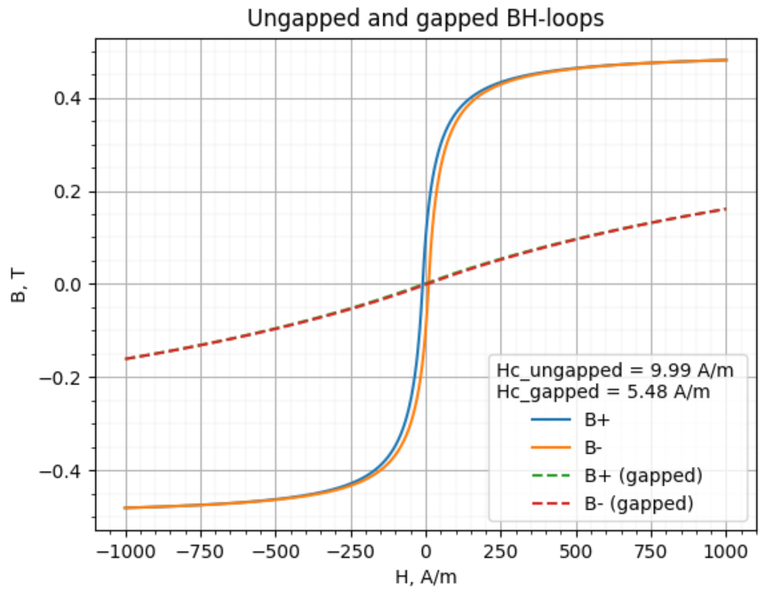
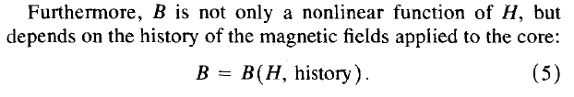
Chan’s model: https://ieeexplore.ieee.org/document/75630

Slide 63
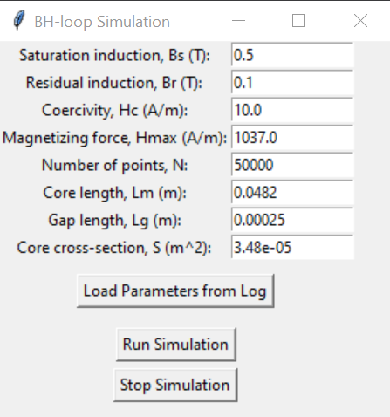

Python program for Chan’s model
# Simulating a BH-loop using Chan's model: https://ieeexplore.ieee.org/document/75630
# Dr. Dmitriy Makhnovskiy, City College Plymouth, England
# Project and reports at GitHub: https://github.com/DmitriyMakhnovskiy/Chan_BH-loop_model
# created 23.02.2024; updated 03.03.2024
import tkinter as tk
from tkinter import messagebox
import matplotlib.pyplot as plt
import csv
import logging
from scipy.interpolate import interp1d
mu_0 = 1.25663706212e-6 # vacuum magnetic permeability
# Other parameters used for simulations:
# Hc - coercivity without a gap, A/m
# Hmax - maximum magnetization (+/-) when drawing the BH-loop
# Br - residual induction, Tesla (T)
# Bs - saturation induction, T
# Lm - length of the magnetic core (single loop) without a gap, m
# Lg - length of the gap, m
# S - cross-section of the magnetic core, m^2
(see Appendix and GitHub)
Project on GitHub: https://github.com/DmitriyMakhnovskiy/Chan_BH-loop_model
GUI
In Chan's paper, they don't explain how to solve differential equations with nonlinear inductors. Their main goal was to propose a fairly simple model of hysteresis, including minor BH-loops. This model is then used by the LTspice simulator in its internal procedures for numerically solving differential equations.

Slide 64
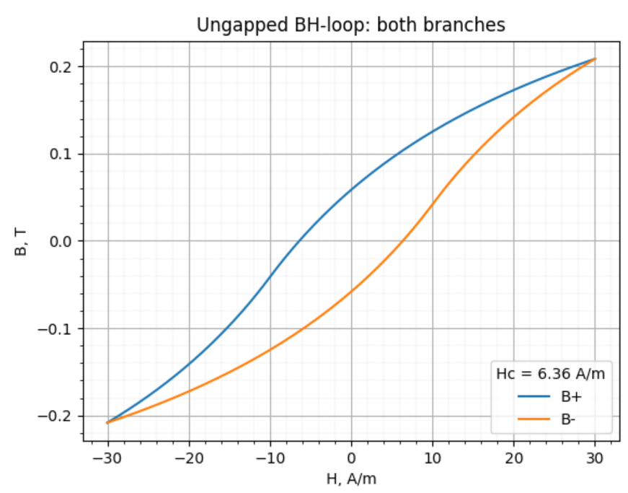
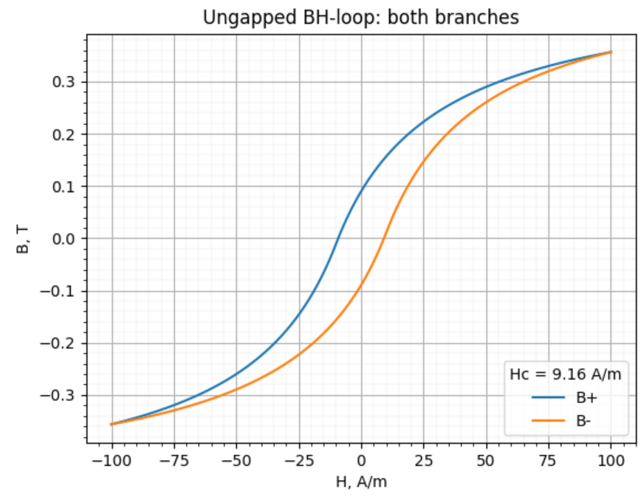
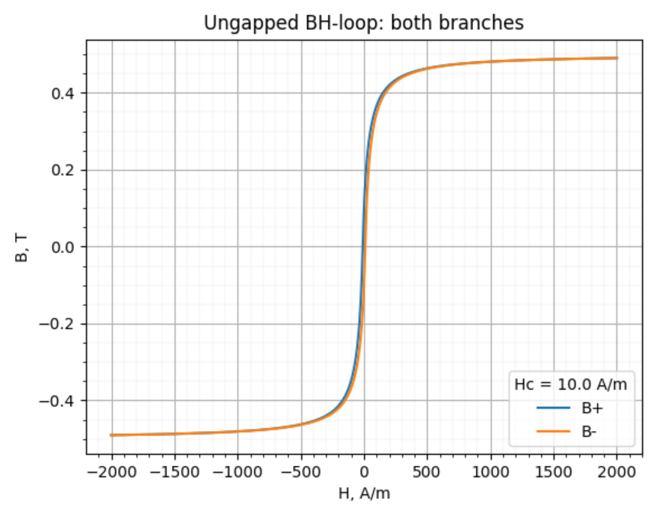
Algorithm for calculating minor BH-loops in an ungapped single loop core
GitHub: https://github.com/DmitriyMakhnovskiy/Chan_BH-loop_model

Slide 65
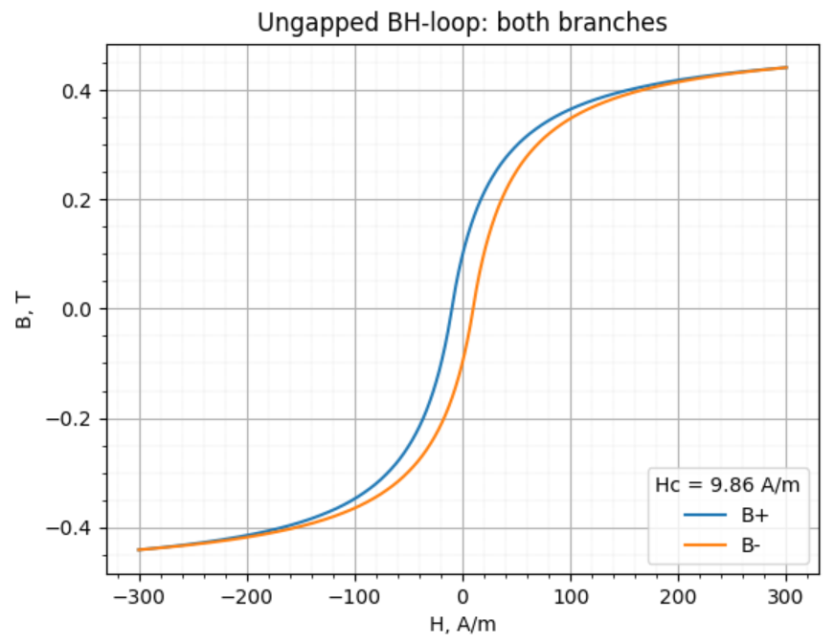
A scheme for recalculating an ungapped minor BH-loop into a gapped loop
However, there are several nuances when implementing this scheme, due to the presence of two branches of hysteresis. The algorithm for constructing minor gapped loops is discussed in the next slide.

Slide 66
Algorithm for calculating minor BH-loops in a gapped single loop core
GitHub: https://github.com/DmitriyMakhnovskiy/Chan_BH-loop_model

Slide 67
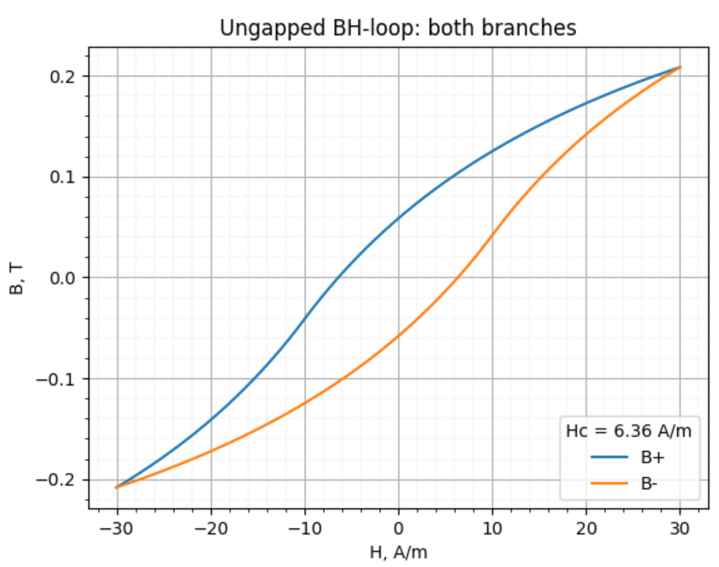

For the ungapped core, some constant permeability μ can only be introduced for a minor BH-loop before the saturation occurs (H_{max} < 30 A/m). We obtain a significant disagreement between the calculated μ and that provided in the datasheet. However, for this core we do not have data for the loop parameters. So, we used some typical values shown in the graph.
The loop parameters used in the simulation.
Chan’s model

Slide 68
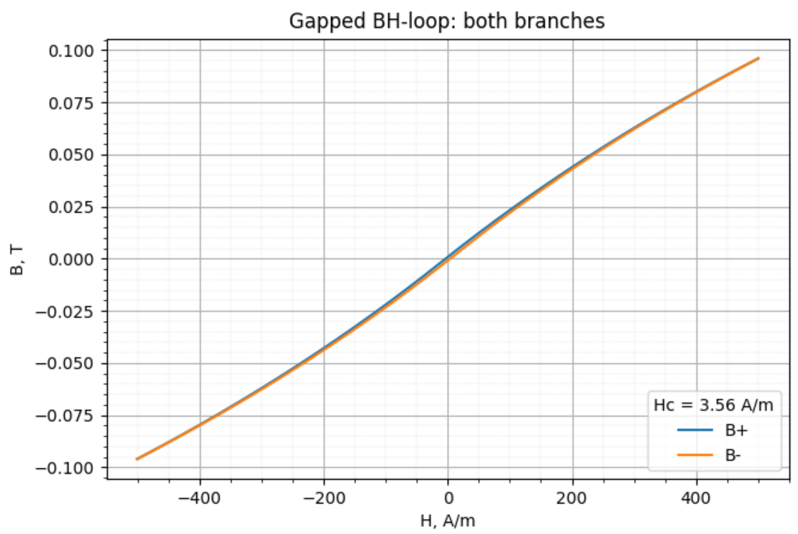
For the gapped core, we obtain a good agreement for μ because the BH-loops become less sensitive to the magnetic parameters. The minor BH-loops can be measured and calculated for much larger magnetising forces before the saturation occurs.
Chan’s model

Slide 69
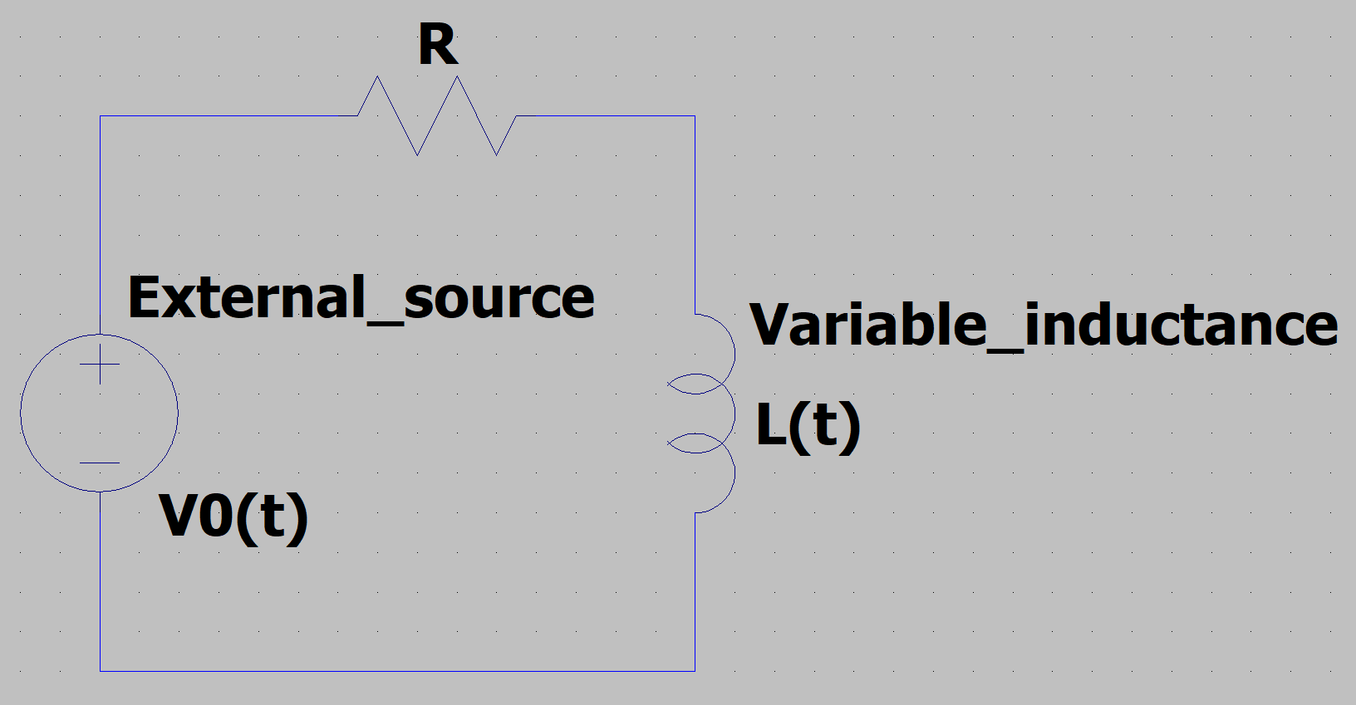
Simulating the LR-circuit with a variable inductance
The LTspice simulator will numerically solve this nonlinear differential equation with an initial condition I(0) = I₀.

Slide 70
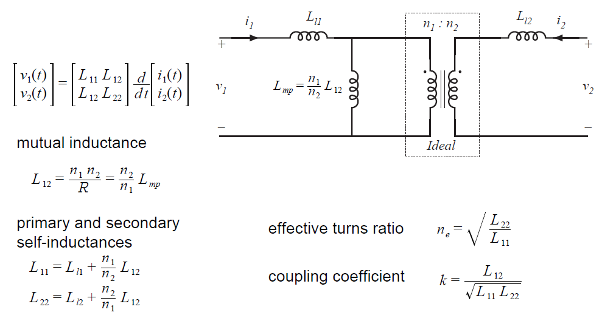

https://www.allaboutcircuits.com/technical-articles/simulating-non-linear-transformers-in-ltspice/
$$L_{l1}−primary leakage inductance$$
$$L_{l2}−secondary leakage inductance$$
Leakage inductances should not depend on the core magnetic properties
LTspice does not allow to simulate arbitrary coupled inductors, there are some workarounds to get non-linear transformers simulated. The easiest way is to model a perfect transformer using dependent sources and then, add in parallel the non-ideal inductor (Chan’s model discussed above).

Slide 71
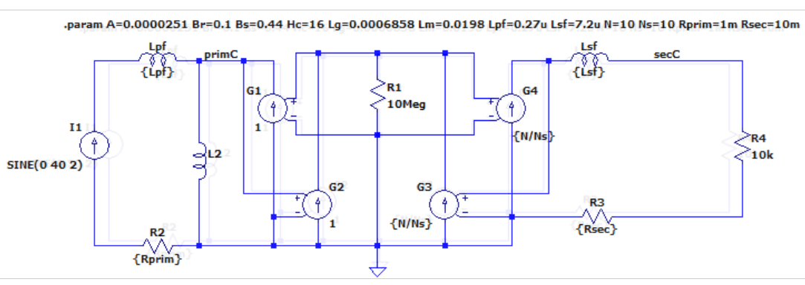
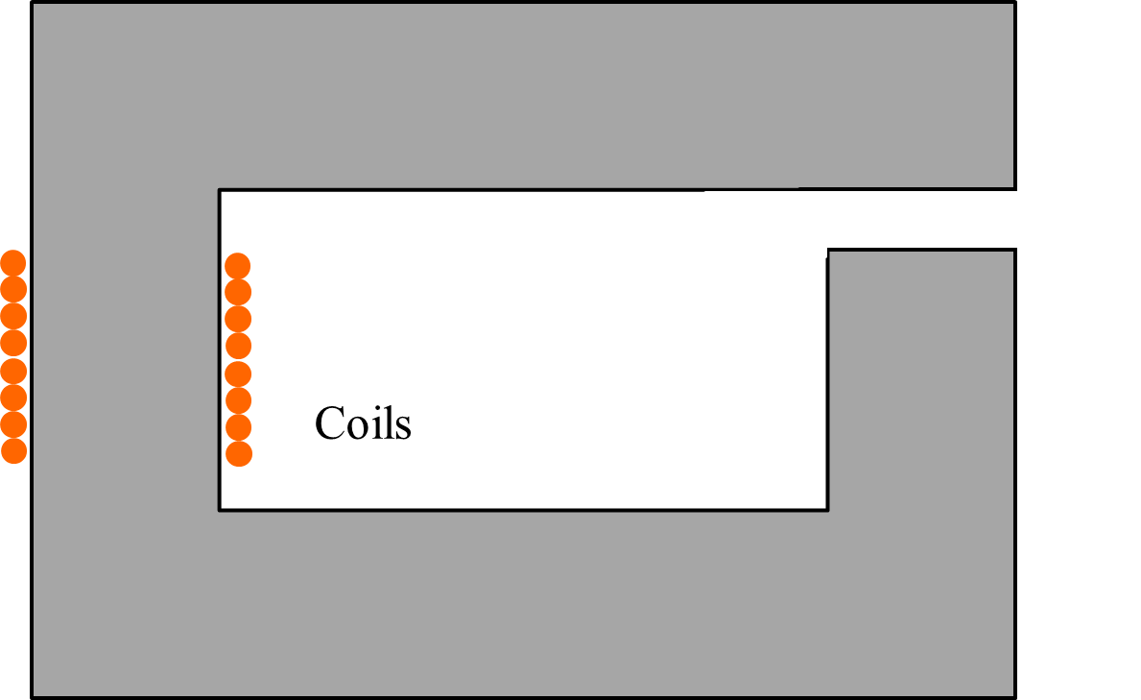
https://www.allaboutcircuits.com/technical-articles/simulating-non-linear-transformers-in-ltspice/
Leakage inductance
Leakage inductance
Non-ideal inductor
G1,2,3,4 – dependent sources
http://engredu.com/2022/05/22/ltspice-dependent-sources/
Ideal transformer: implementation using G1,2,3,4
LTspice does not allow to simulate arbitrary coupled inductors, there are some workarounds to get non-linear transformers simulated. The easiest way is to model a perfect transformer using dependent sources and then, add in parallel the non-ideal inductor.

Slide 72
https://www.allaboutcircuits.com/technical-articles/simulating-non-linear-transformers-in-ltspice/
N – primary coil
Ns – secondary coil
Chan's paper assumes a single-loop magnetic circuit. However, we need to understand how to provide these parameters if the circuit has branches.
Coil, N

Slide 73
Chan’s model used in LTspice assumes a single loop magnetic circuit. In our case, we have a branched circuit. However, note that the sum of the cross sections of the blue and red segments is very close to the cross section of the red segment (as it should be). Therefore, this branched circuit can be replaced by a single loop circuit with the cross-section of 34.81 mm² and the length equal to twice the length of all segments, minus the gap. Thus, we get for LTspice: L_{m} = 4.82×10⁻² m, L_{g} = 2.5×10⁻⁴ m, A = 3.48 ×10⁻⁵ m². Other magnetic parameters were not provided for our E-shape core. So, we will use some typical values: B_{s} = 0.5 T, B_{r} = 0.1 T, and H_{c} = 10 A/m.
18.59 mm²
18.29 mm²
34.81 mm²
Total symmetrical gap!

Slide 74
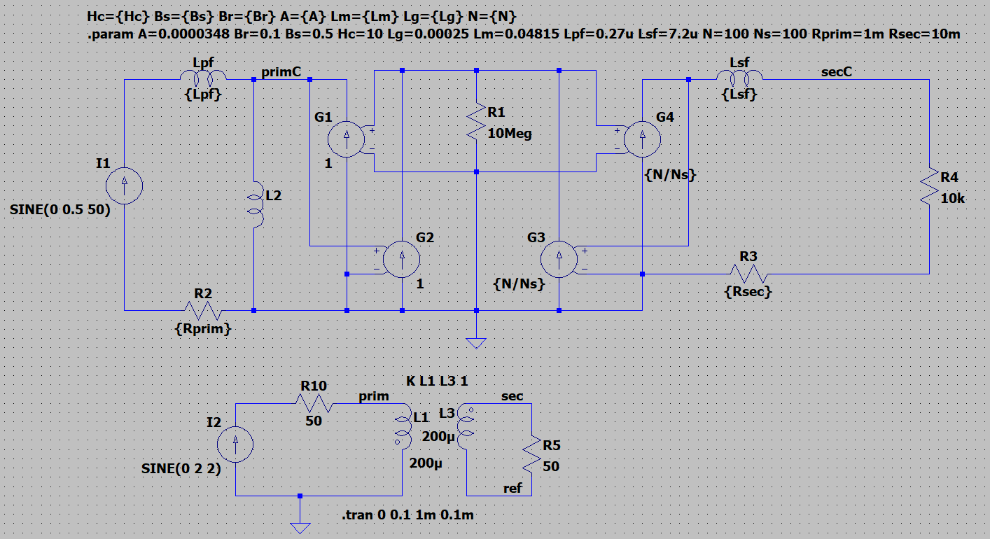
L_{m} = 4.82×10⁻² m, L_{g} = 2.5×10⁻⁴ m, A = 3.48 ×10⁻⁵ m². B_{s} = 0.5 T, B_{r} = 0.1 T, and H_{c} = 10 A/m, N = N_{s} = 100

Slide 75
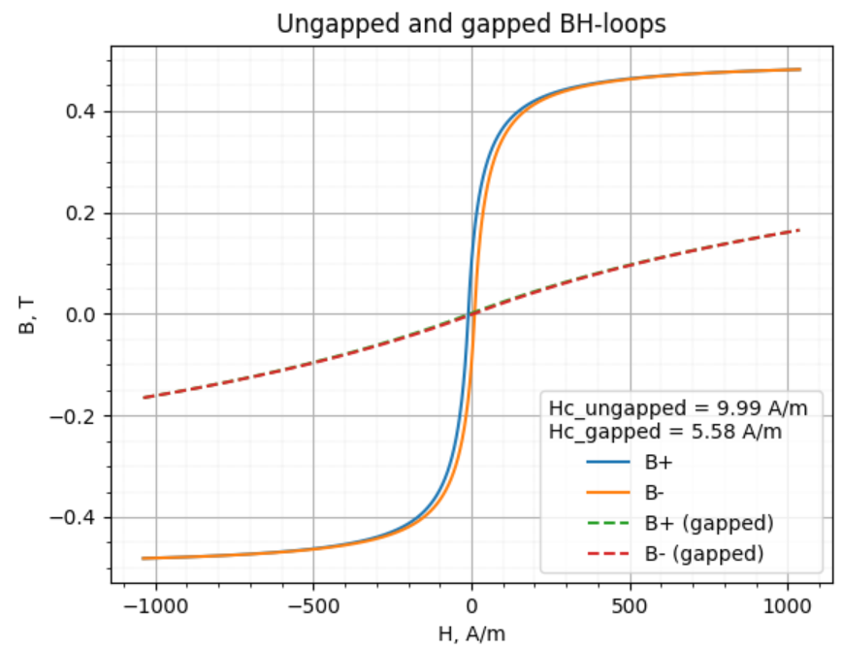

Chan’s model
The hysteresis BH-loop, calculated without a gap, is already highly saturated even with an AC excitation current of 0.5 A. However, introducing a gap will significantly reduce the magnetic flux density inside the core, resulting in an unsaturated loop. This aligns well with the calculations we have performed for this core.
$$For A_{L}=171 \left(gaped\right) and N=100: I_{DC}≈0.5 A$$

Slide 76
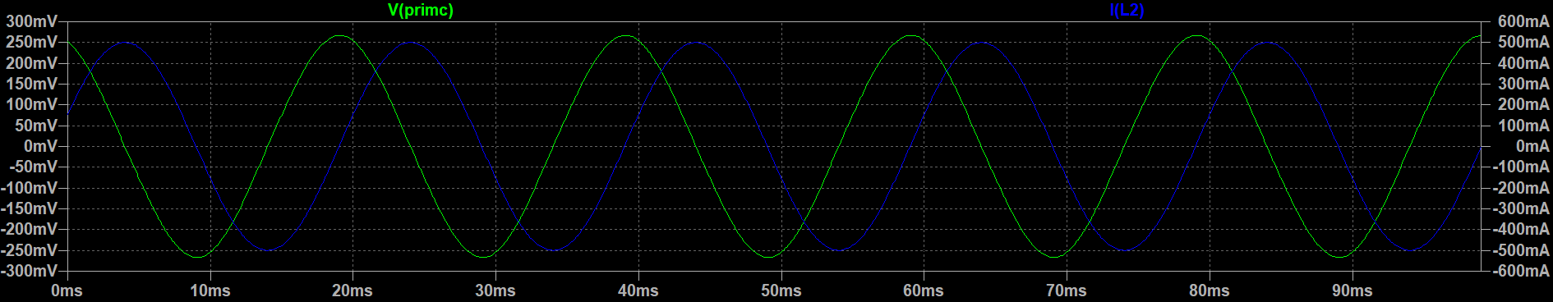
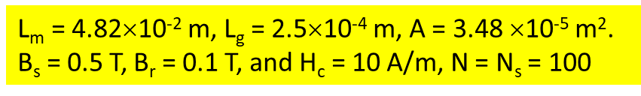
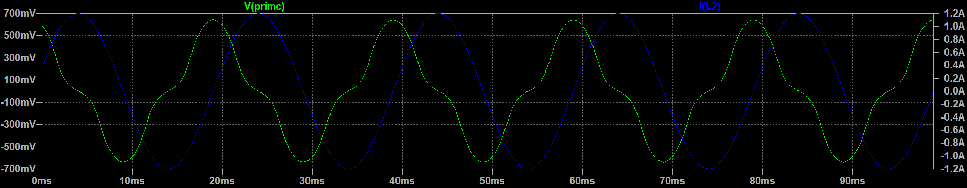
Current source: 0.5 A, 50 Hz
Bias current: 0, DC
Gapped
Voltage across L₂ (primary)
Current through L₂
There is still no visible distortion of the primary voltage
Very strong non-linear distortions of the primary voltage
Current source: 1.2 A, 50 Hz
Bias current: 0, DC
Gapped
Voltage across L₂ (primary)
Current through L₂

Slide 77
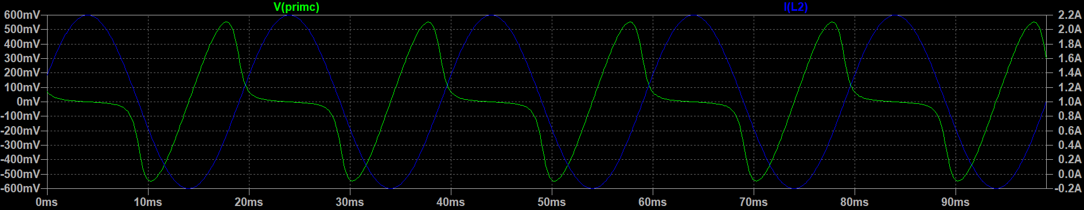

Gapped
Current source: 1.2 A, 50 Hz
Bias current: 1 A, DC
Voltage across L₂ (primary)
Current through L₂
The core is fully saturated by the bias current 5 A. Magnetic permeability is close to 1. Low non-linear distortions.
Current source: 1.2 A, 50 Hz
Bias current: 5 A, DC
Gapped
Voltage across L₂ (primary)
Current through L₂

Slide 78

Ungapped
Current source: 0.5 A, 50 Hz
Bias current: 0, DC
Voltage across L₂ (primary)
Current through L₂
Chan’s model

